Slide 1

Deep News: Trading ETFs with News Data

Slide 2
The Data
Target:
High Volume
Input Data
Minute OHLCV Data for 16 ETFs since 2013 (Ticker)
~600,000 Financial News Articles since Dec. 2017 (Text)
High Volatility
Notes:
OHLCV: Open High Low Close Volume. Volume represents how many trades occurred over a given time frame, in our case, minutes. Volatility represents the standard deviation of a given price over a given time frame. For this project, we are attempting to solve a binary classification problem for each ETF: whether or not any of the given ETFs are trading with both higher than usual volume and volatility (>50th percentile).

Slide 3


Dual Model Problem Statement
Ticker Data
Hypothesis:
Morning Market behavior is indicative of intra-day market behavior
Text Data
Hypothesis:
Morning news is indicative of intra-day market behavior
Notes:
Our goal is to day trade ETFs based on whether or not we have predicted that a given ETF will have higher than usual volume and volatility. The hypotheses surround our available data; the assumption is that it contains some predictive capabilities.

Slide 4
Relative Strength Index Strategy
RSI Measures
Oversold (>70)
Overbought (<30)
Performs well under
High Volume
High Volatility
Strategy
Buy at 30
(Short) Sell at 70
Liquidate at End-of-Trading-Day
Notes:
The RSI strategy is one that attempts to encompass the “mean-reversion” of a given asset. On a given trading day, asset prices fluctuate. The goal of RSI is to capture when an asset may be at the bottom or top of a fluctuation and our strategy hopes to take advantage of this.

Slide 5
Final Model
Deep Learning
Text Model
Load & Clean Data
Combined Model
Deep Learning
Ticker Model
Raw Data Lake
Text
Ticker
Test Performance
New Raw Data
Live Trading

Slide 6
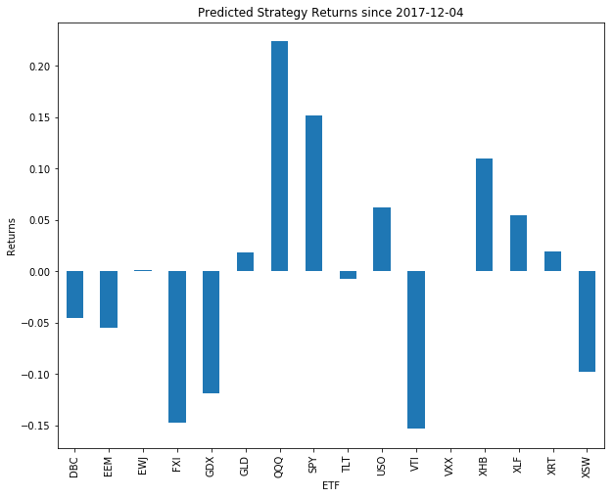
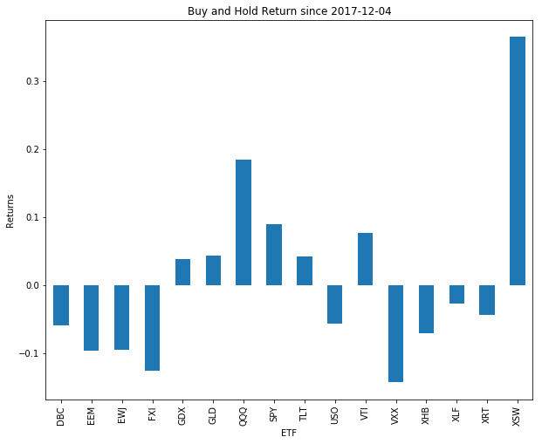
Model Performance
Out-performed on 10 out of 16 ETFs
DBC, EEM, EWJ, QQQ, SPY, USO, VXX, XHB, XLF, XRT
Results NOT statistically significant at 0.10 level
Daily and Weekly Returns
Notes:
Although our model beats Buy and Hold on a back test from a returns standpoint, these results were not statistically significant for daily or weekly returns. This simply means that it is very possible we just got lucky and that in the long run this strategy wouldn’t necessarily work. To combat this, we have many parameters we would need to optimize.

Slide 7
Recommendations
Data
Update ETF Universe
More News Sources
Alternative Text Data
Parameters
Capital Allocation
Volume & Volatility Cut-off
Stop Loss & Take Profit
Notes:
We have many opportunities to improve the strategy. Since we beat buy and hold but the strategy was not statistically significant, it is possible to add more optimization in an attempt to develop a truly robust winning strategy.

Slide 8
Recommendations
Strategy
Optimized Underlying System
Fit Models to Intra-Day Data
Performance
Risk Metrics
Sharpe Ratio
Max Draw-down
Notes:
One of the main things to note is that we are buying at 30 RSI and (short) selling at 70 RSI. This is not fully optimized and could be improved with machine learning. Furthermore, we are only measuring performance on returns whereas we can also begin to incorporate more complex measurements into our backtest.

